Slide 1

Hi!, I am Dariel Muhammad Ramadhan
Welcome to my personal portofolio

Slide 2

ABOUT ME
Hello! I’m Dariel Muhammad Ramadhan, a passionate individual with a profound interest in the realm of data analysis and science. My journey into the world of data was driven by a curiosity to unravel meaningful insights from the vast sea of information that surrounds us.
I am proficient in various tools and languages, including Python, and I continually strive to stay at the forefront of emerging trends and technologies in the dynamic field of data science. My goal is to not only analyze data but also to tell compelling stories through visualizations, making complex concepts accessible to diverse audiences.

Slide 3



Personal Skill
Ms.Excel
Statistics
Programming
Languange
Pivot Table/ Power Query
Data Exploration (EDA),
Descriptive Statistic, A/B Test,
Cohort Analysis, Correlation
Analysis, Clustering
library: Numpy, Pandas,
matplotlib, seaborn, sklearn

Slide 4
Notable Project!

Slide 5
FLOWCHART OF POKEMON DATA
START
Data Collection
Data Cleaning
Data Exploration
TRUE
TRUE
Insights and Recommendations
Statistical Analysis
TRUE
Visualization
END

Slide 6
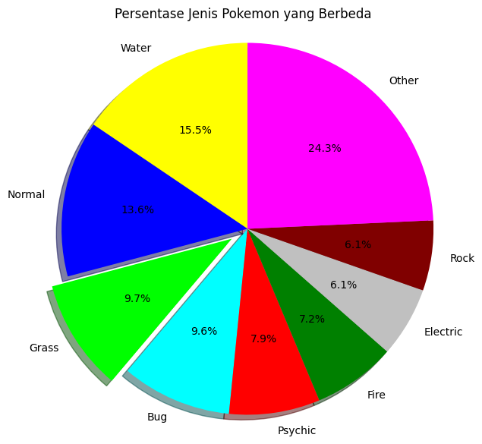
Python Project
Data Source : Pokemon data on google colab
The pie chart illustrates the distribution of Pokemon types in the dataset in an easily understandable manner. The "Water" type Pokemon dominates with the highest percentage, followed by the "Normal" type, which is also quite significant. The "Grass" type Pokemon is also notably present, particularly emphasized with the exploded slice effect. Additionally, various colors such as blue, red, green, and others represent different Pokemon types. In the magenta section, there is a category labeled "Other," encompassing Pokemon types not included in the main categories. From the chart, it can be inferred that the dataset is predominantly composed of "Water" type Pokemon, while other types contribute to a lesser extent.

Slide 7
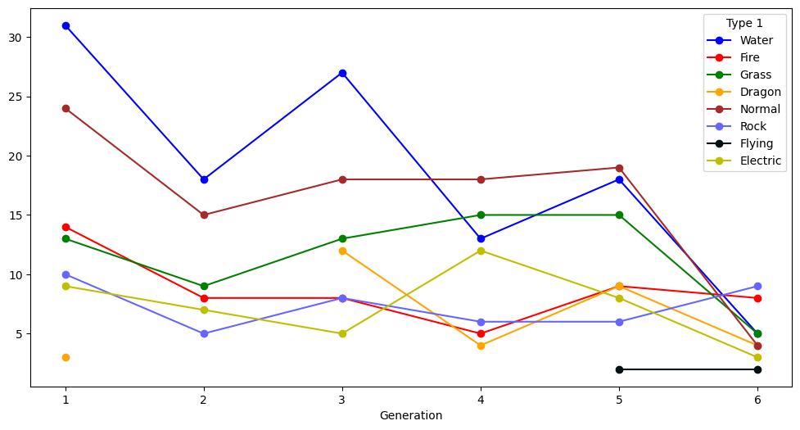
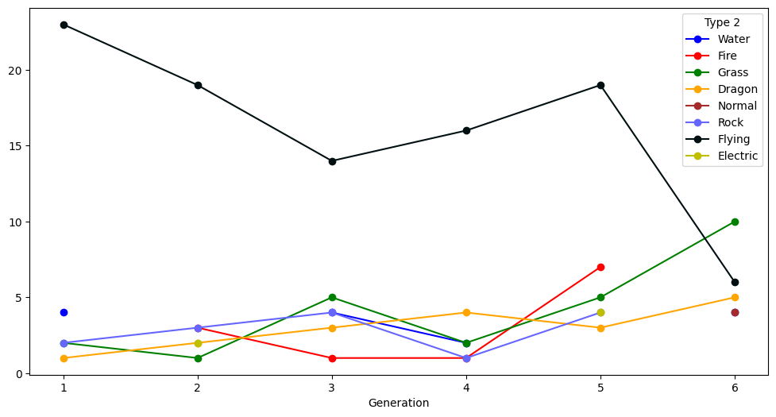
Evolution of Pokemon Types Across Generations
The visualization depicts how the number of Pokemon belonging to specific types, such as Water, Fire, or Grass, changes across different generations of the Pokemon game. Each line represents a distinct Pokemon type, and the horizontal axis indicates the generations. By examining the chart, we can observe whether certain Pokemon types are more prevalent or dominant compared to others over time. This graph provides a dynamic overview of the evolution and shifts in Pokemon types throughout various generations, aiding in the understanding of trends and patterns in the Pokemon world.
More visualization data of pokemon : https://github.com/DarielRamadhan/Dariel-Pokemon.git

Slide 8

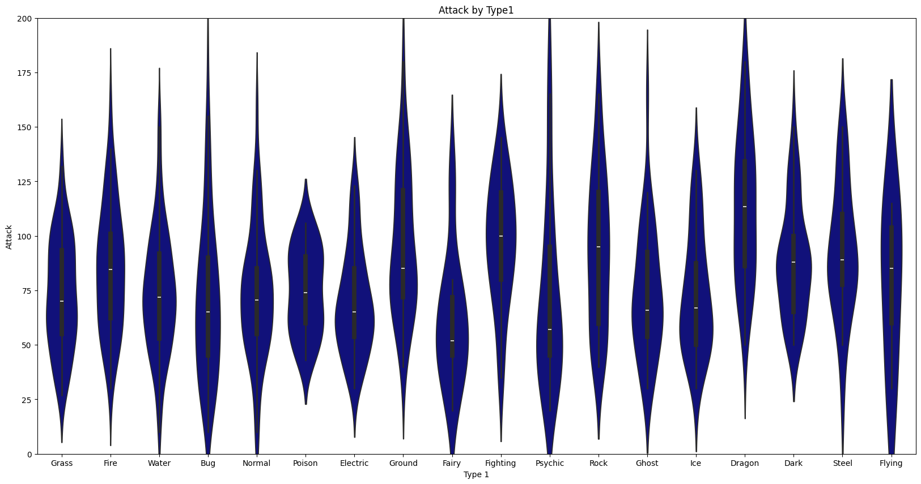
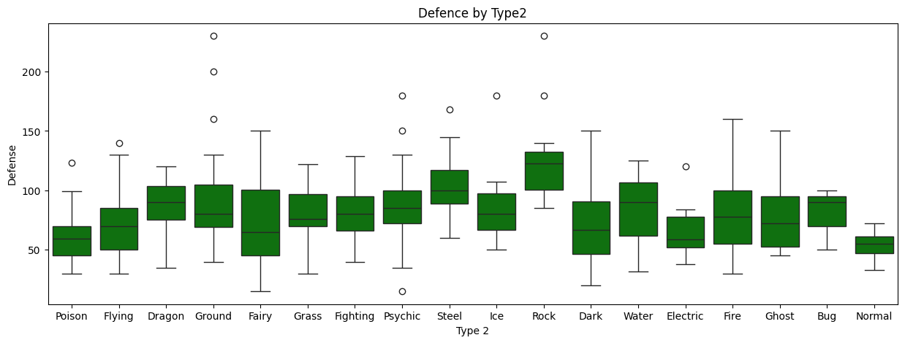
Within my analysis of Pokemon data, several intriguing insights have surfaced:
Dominance of Pokemon Types:
The "Water" type Pokemon consistently dominates the dataset, indicating widespread popularity and availability.
The "Normal" type also boasts significant presence, reflecting the diversity of commonly encountered types.
Legendary vs. Non-Legendary Pokemon Comparison:
A comparison between Legendary and Non-Legendary Pokemon reveals that Non-Legendary Pokemon are far more common than their Legendary counterparts.
The horizontal bar chart vividly illustrates this contrast.
Analysis of Attack and Defense:
The scatter plot visualizes the relationship between Pokemon attack and defense, allowing us to observe the correlation between these two attributes.

Slide 9



Based on my analysis of the Pokemon data, here are some recommendations:
Diversify Type Representation:
Consider introducing events or features in the Pokemon world that highlight less represented types, fostering diversity and providing players with a broader range of Pokemon experiences.
Enhance Legendary Pokemon Encounters:
Since Legendary Pokemon are less common, create special in-game events or challenges that allow players to encounter and catch these rare and powerful creatures. This can add excitement and exclusivity to the gaming experience.
Speed-Based Challenges:
Implement speed-based challenges or events that leverage the insights from the speed distribution analysis. This can introduce a new dimension to gameplay, rewarding trainers with quick and agile Pokemon.
Balancing Attack and Defense:
Explore game mechanics that emphasize the balance between attack and defense attributes. This could introduce strategic elements to battles and encourage players to consider a Pokemon's overall capabilities.
Highlight Unique Type Combinations:
Showcase Pokemon with unique Type 1 combinations that stand out in terms of popularity or rarity. This can add intrigue to the Pokemon world and motivate trainers to seek out these distinctive creatures.
These recommendations aim to enhance the gameplay experience, introduce strategic elements, and celebrate the diverse world of Pokemon. Implementing these suggestions could contribute to a more engaging and dynamic Pokemon universe for players.

Slide 10


Contact me!
EMAIL:
darielmuhammadr@gmail.com
LINKEDIN:
linkedin.com/in/darielmr

